Slide 1

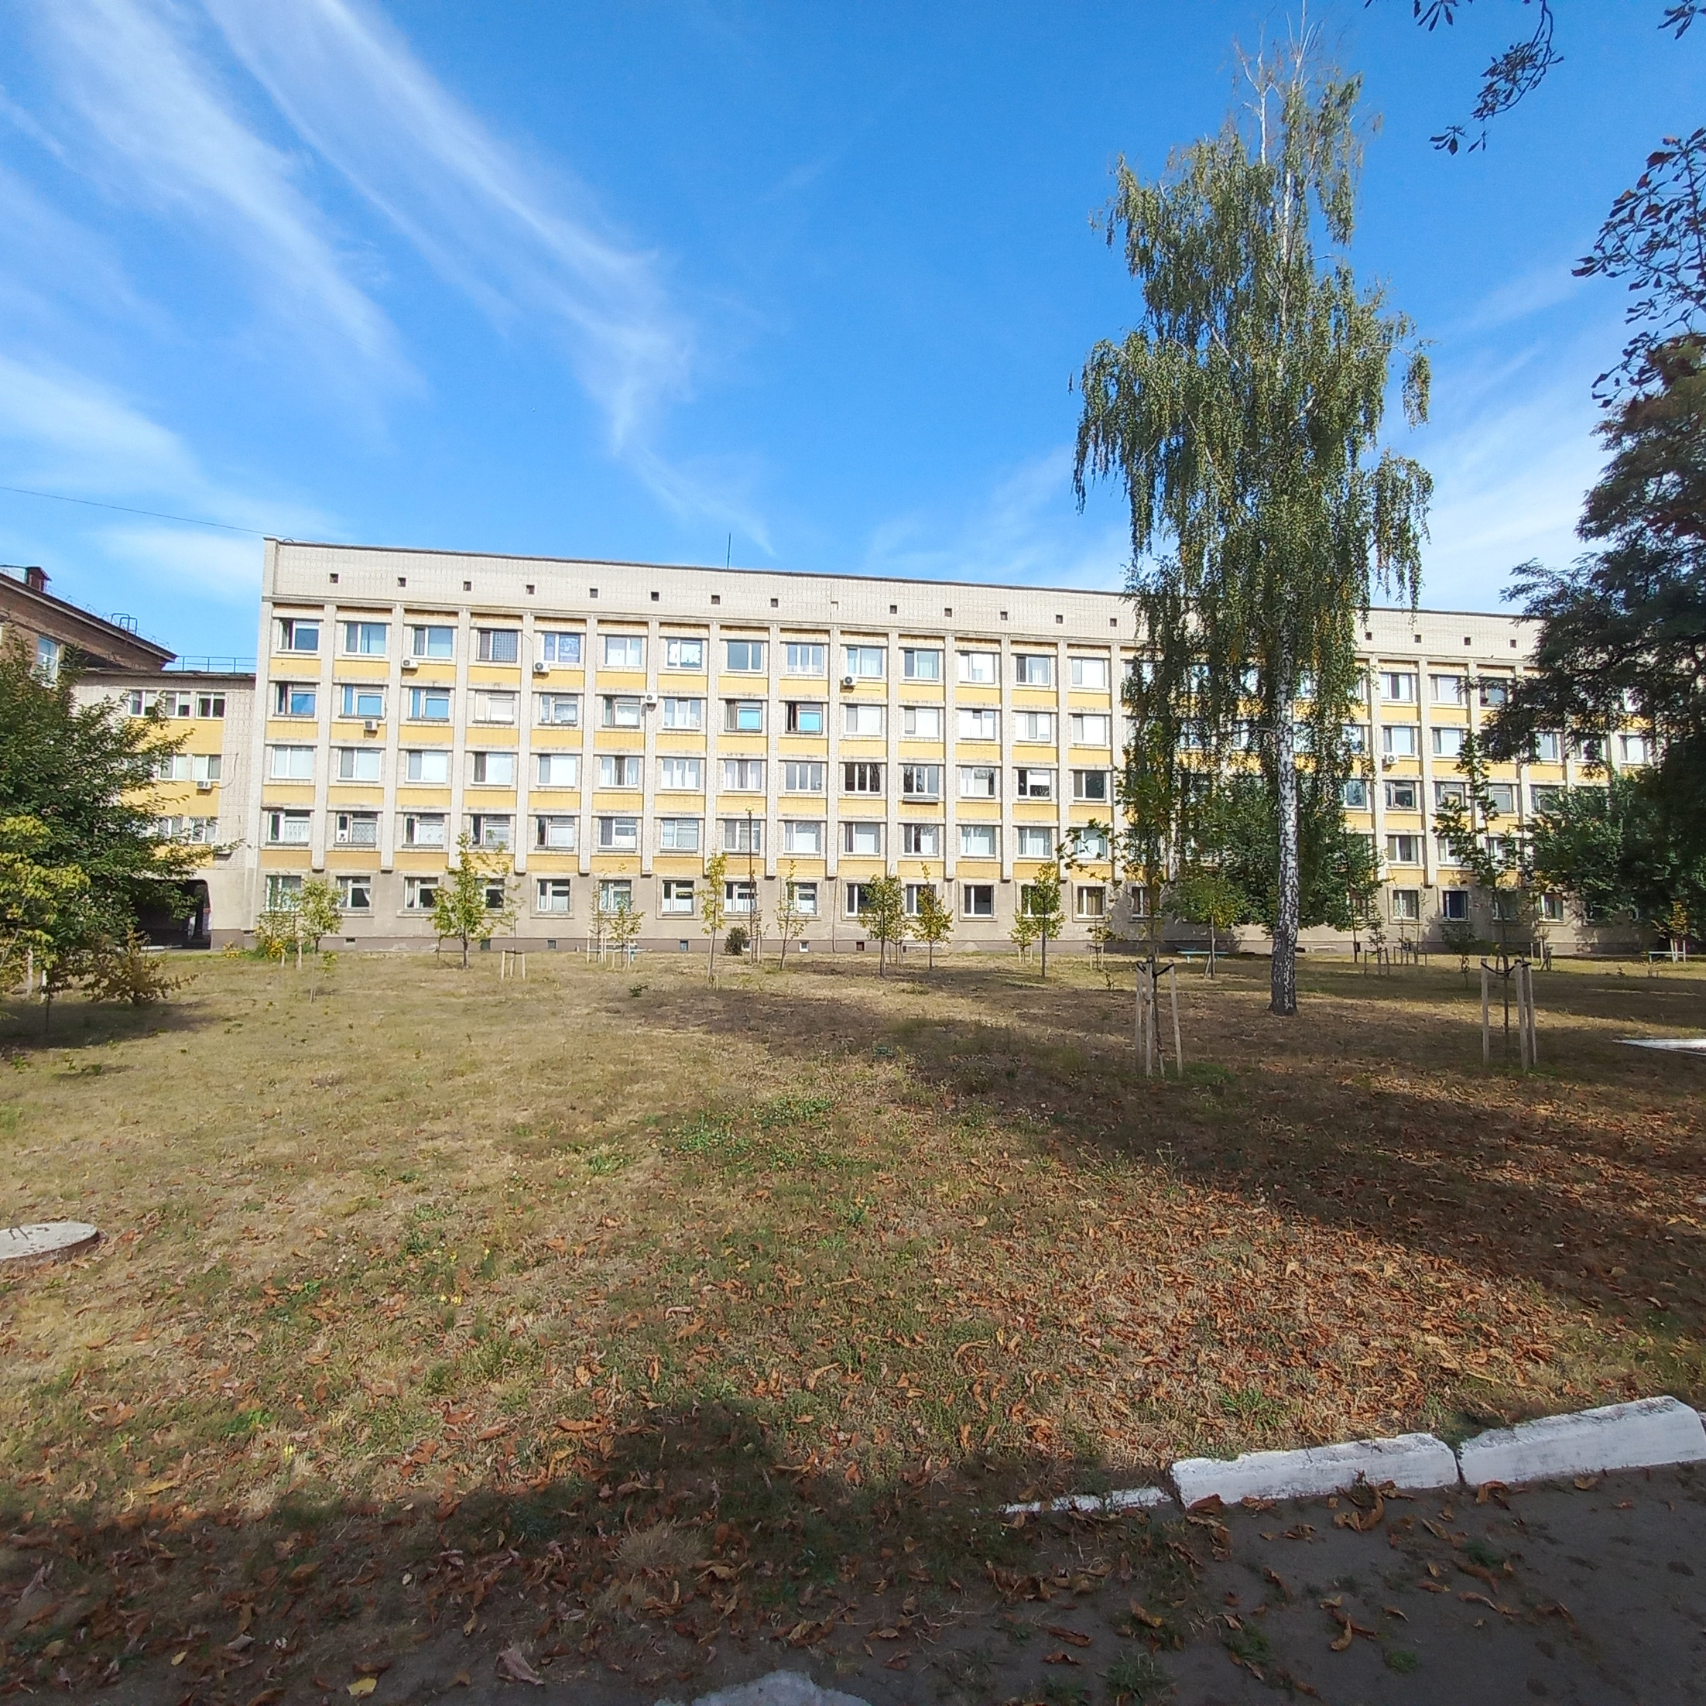
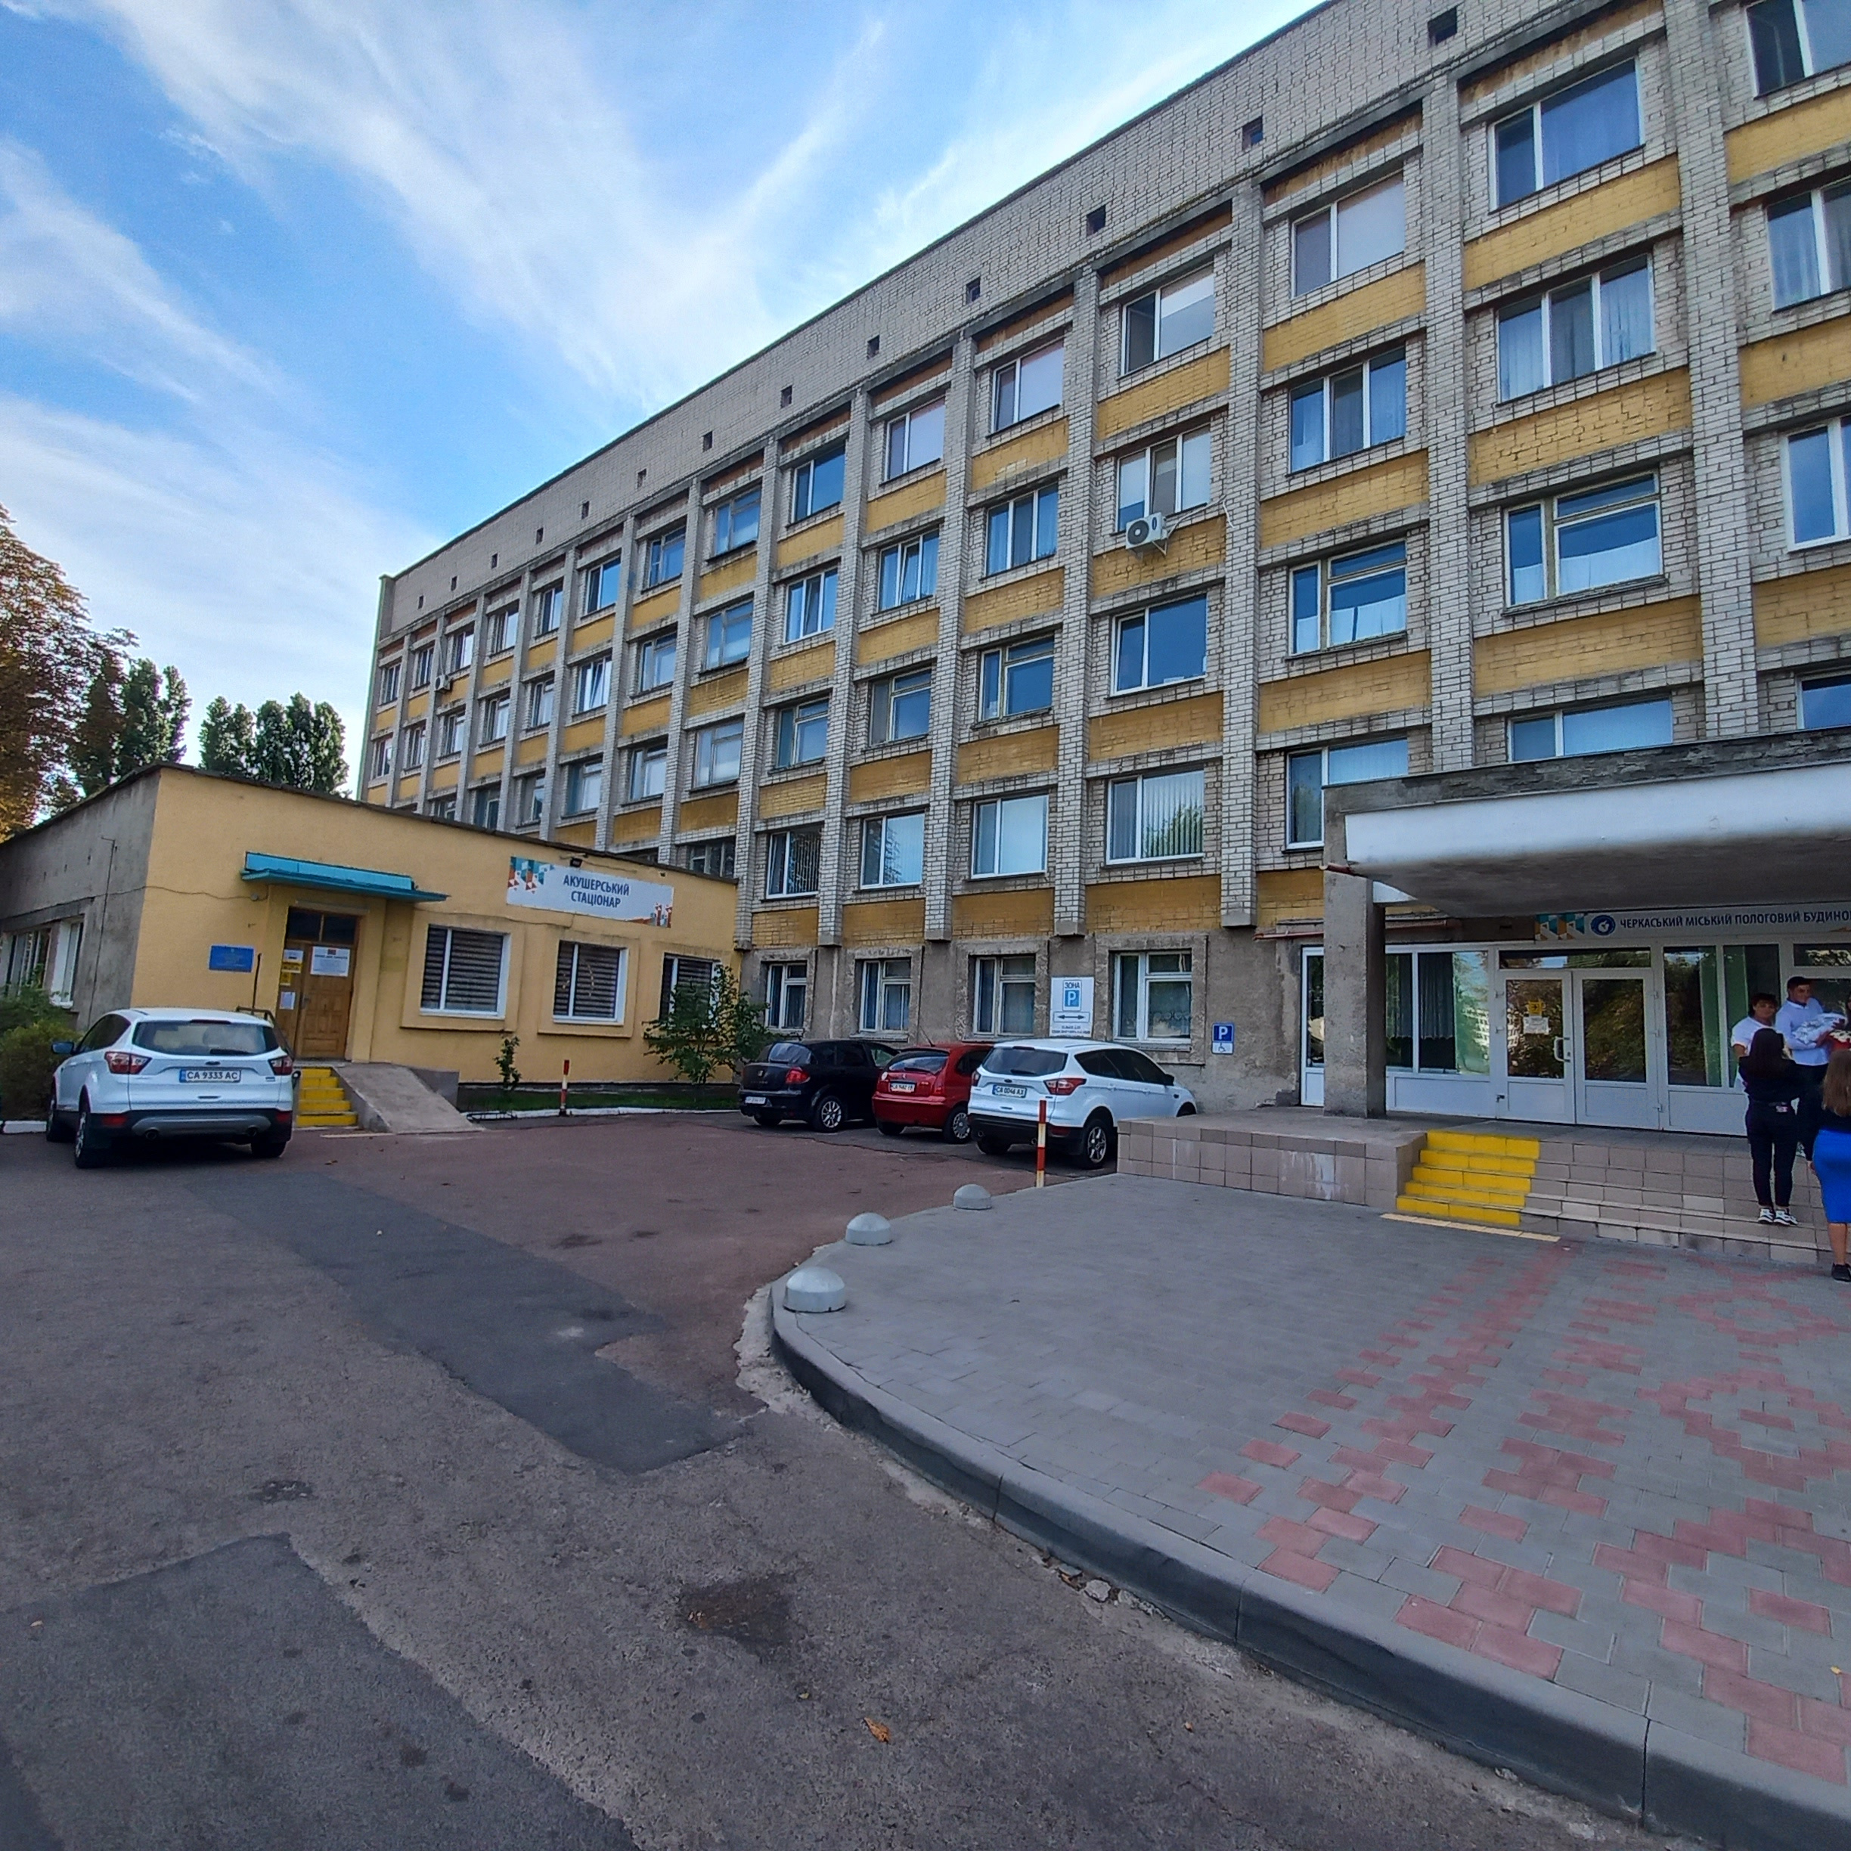








Overhaul of buildings of Municipal non-profit enterprise «Cherkasy City Maternity Hospital «Mother and Child Center»»
The institution provides obstetric and gynecological care 24/7
Contingent of the establishment per year:
Maternity patients: 1 225 individuals
Newborns: 1 227 individuals
Women: 82 596 individuals, of whom 710 have undergone surgery
The total cost of the project is
≈ 1 780 400 EUR

Slide 2


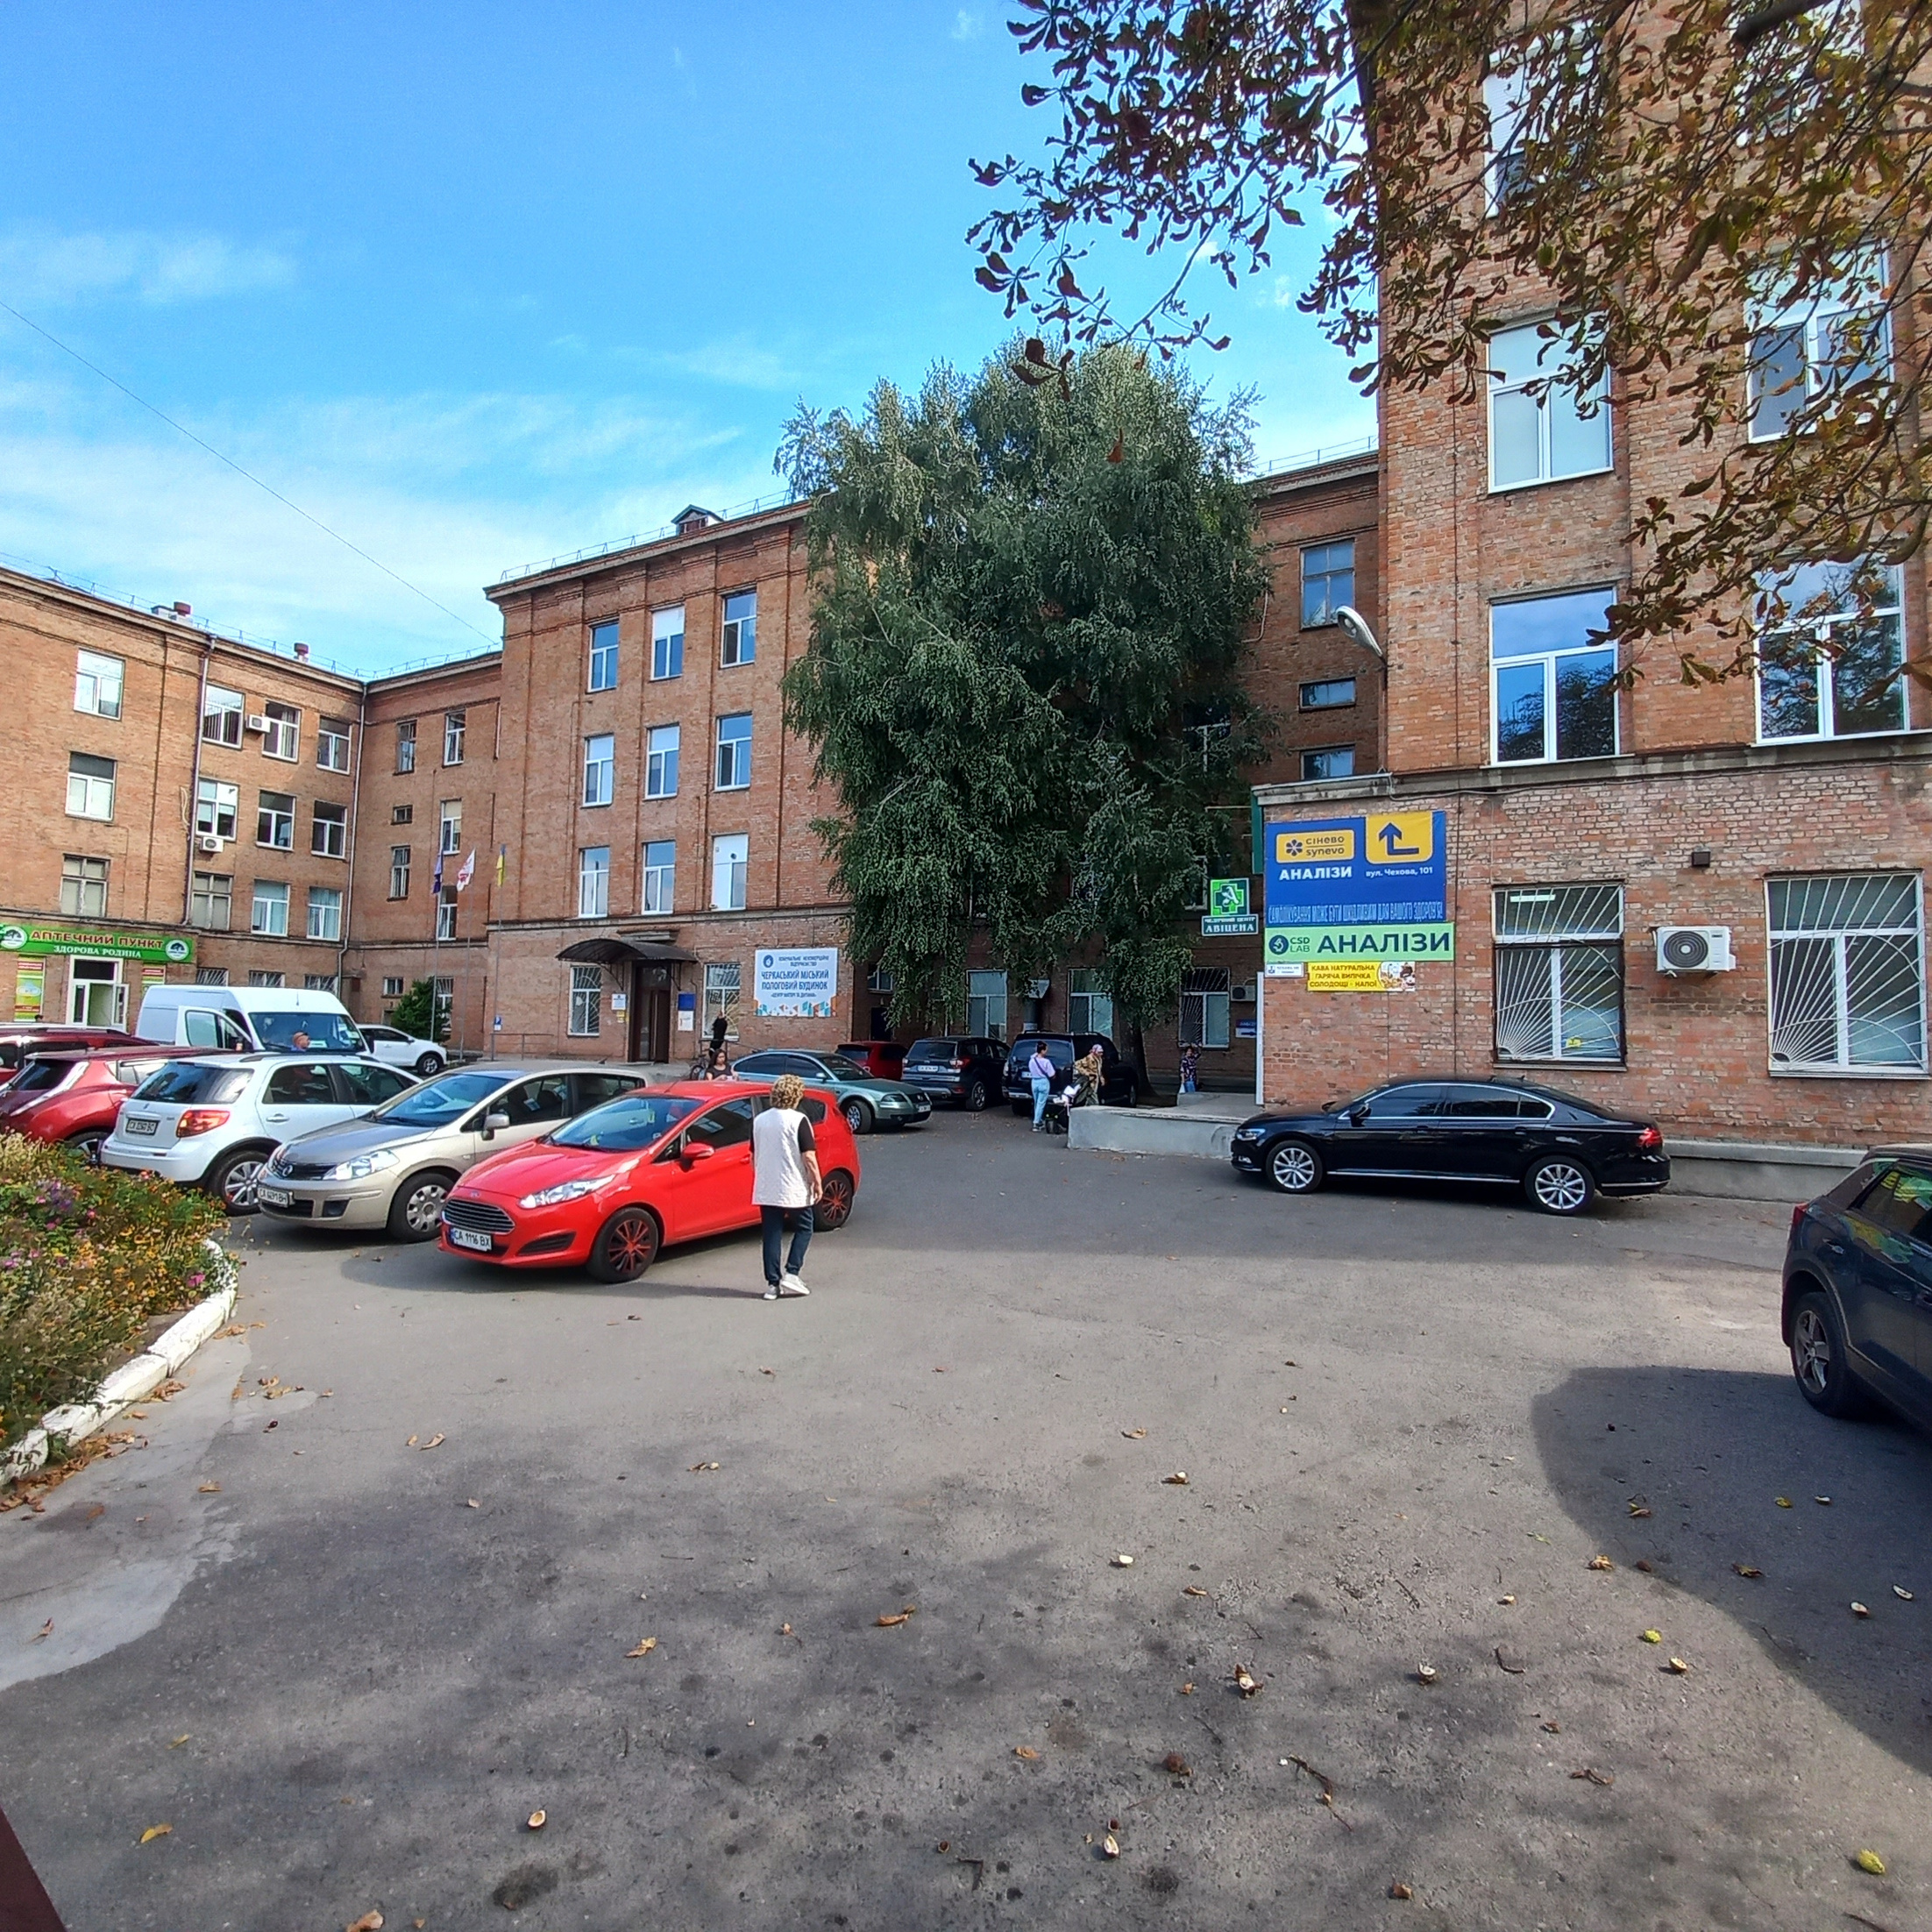





The project includes the following works:
facade renovation of the buildings
thermal modernization of building
connection to independent power sources
replacement of old wooden blocks
with new ones
arrangement of buildings entrances to ensure accessibility for people with limited mobility

Slide 3
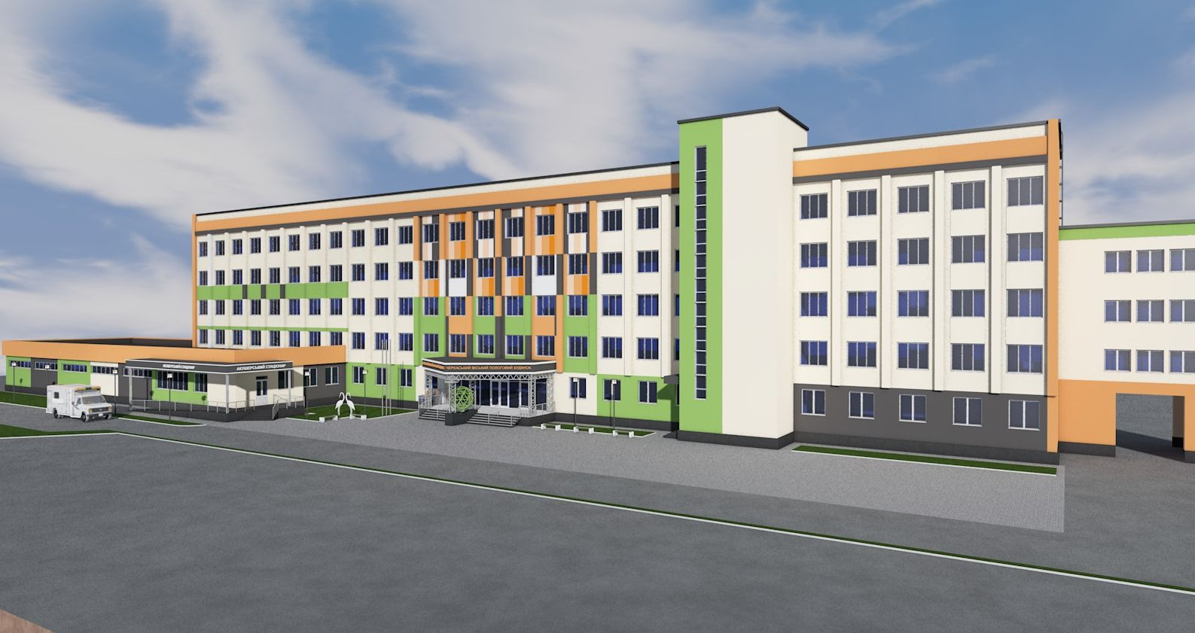



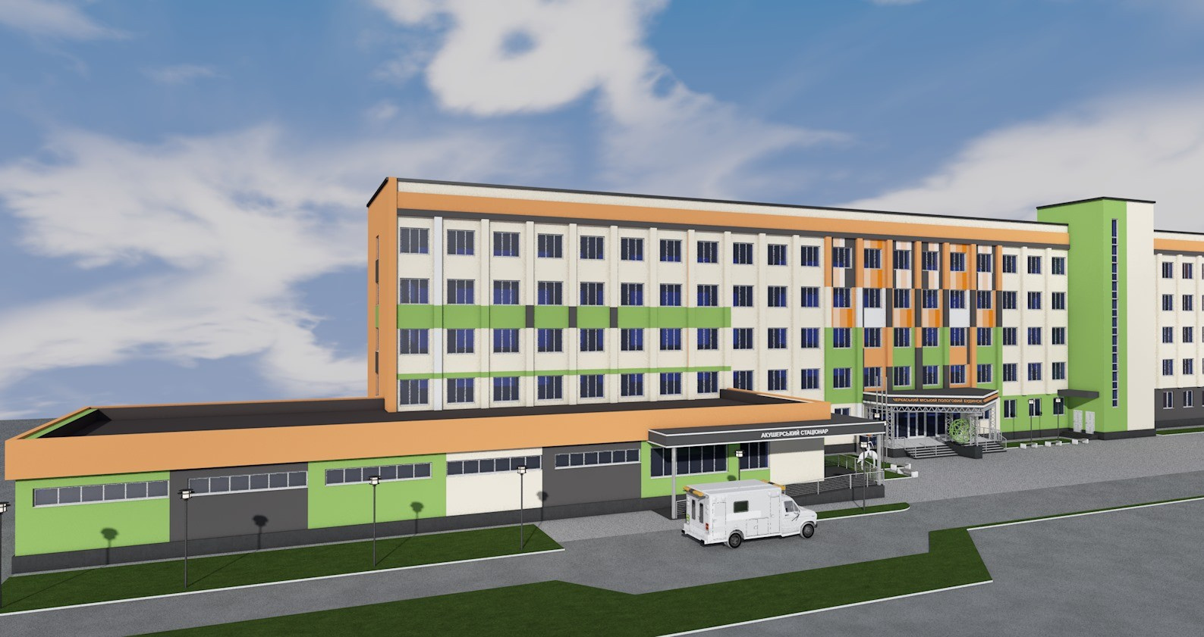


The insulation and renovation of the establishment’s buildings facades
will ensure:
temperature conditions inside the premises
an optimized temperature regulation within the premises
preservation of external enclosing structures and facade elements from the effects of aggressive environmental conditions
increasing the degree of inclusiveness of the building
increasing the number of births by 500 cases

